Slide 1

2017 Devon IT Hackathon
Danny.Burrows
Don.Morrison
Steve.Pankratz
Jon.Slominski

Slide 2
Problem Statement / Introduction
Completions visualizations for the field
What nobs can PIC turn?
Rate
Chemical Concentration (gel, FR)
Sand concentration
What moves the needle?
Safety
Time pumping
Horsepower brackets
Avoiding operational shutdowns
https://goo.gl/qeTRf1

Slide 3

Tools
.NET Core / .NET Standard
Azure Event Hub
Azure Search
Azure ML Studio
Azure Storage
Angular
Serilog
Application Insights
Visual Studio Team Services
Slack
https://goo.gl/qeTRf1

Slide 4










Flow
Engineering limits
Azure SQL
BI/Reporting
PI Historian
Contracts
Pump Schedule
Event Hub
Azure Stream Analytics
Event Hub
Responsive Web App
Streaming API
Addl. Data Integrations
https://goo.gl/qeTRf1

Slide 5
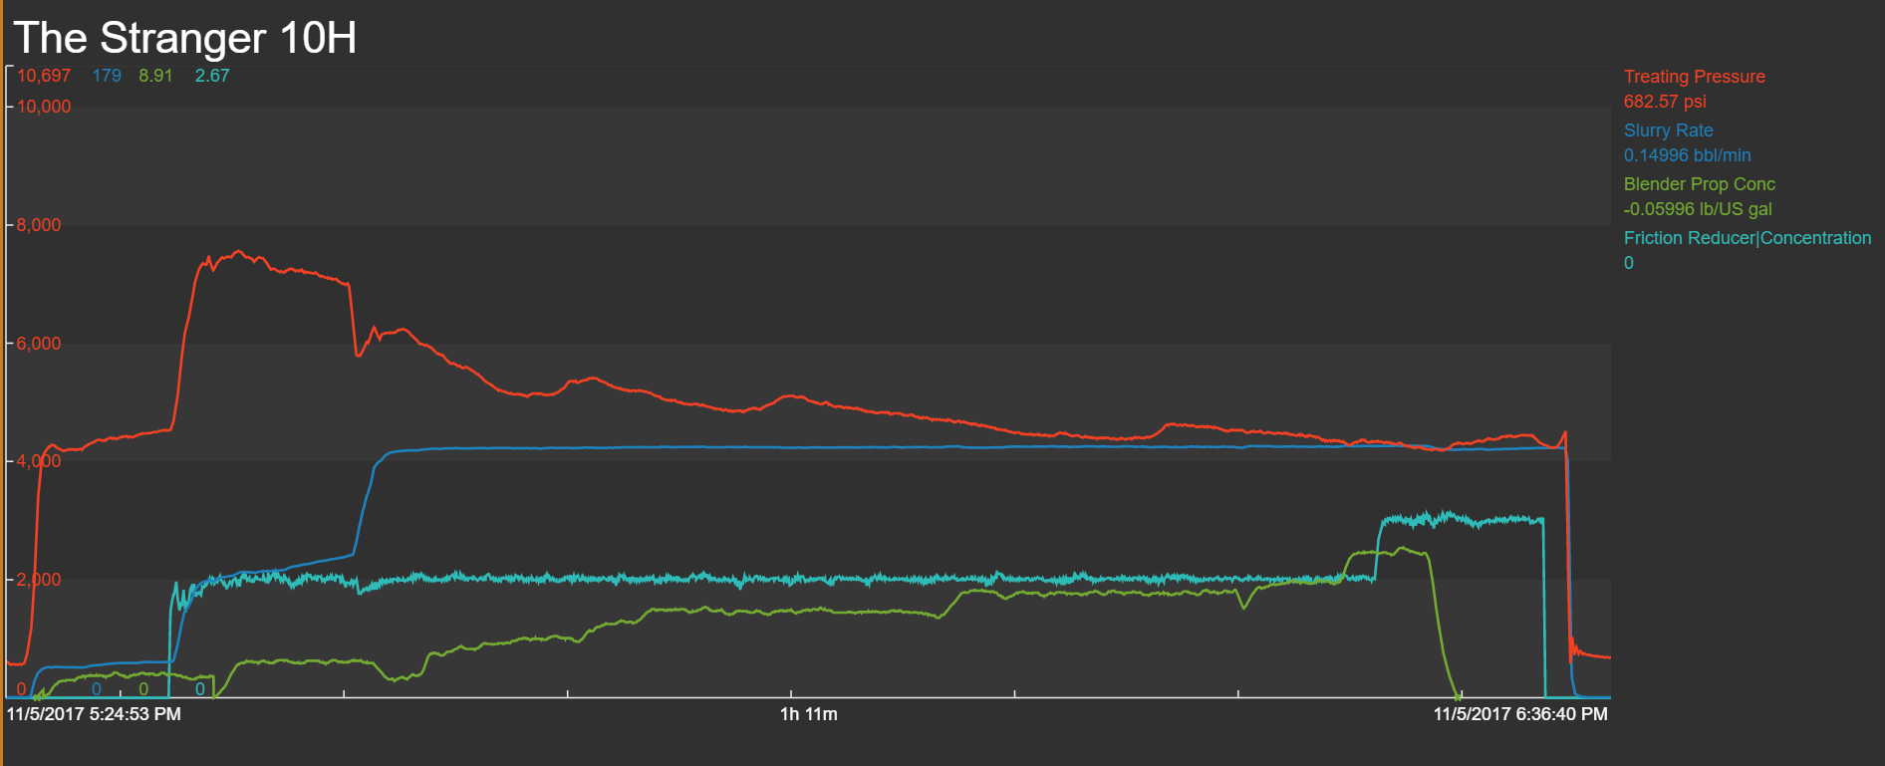
Stage Example
https://goo.gl/qeTRf1

Slide 6

Leaderboard
FRAC LEADER BOARD
1
JOHNNY G.
2
JIMMY T.
3
DRAGON
Try it @:
https://goo.gl/qeTRf1
4
BIG BEARD
5
CHARLES P.
6
STRANGER PIC
7
A GEOLOGIST
SHARE
https://goo.gl/qeTRf1

Slide 7
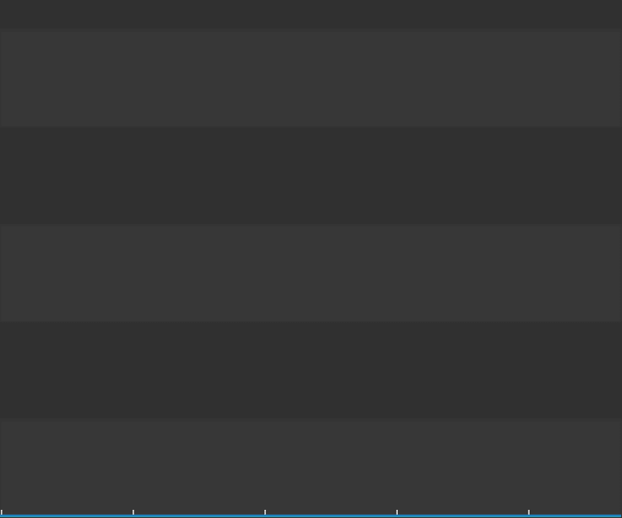
Time to Take Action
https://goo.gl/qeTRf1

Slide 8
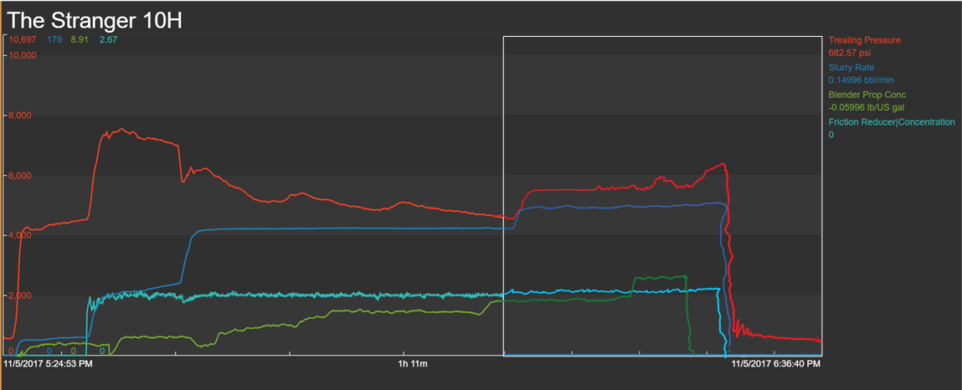
Result of Action
New, higher rate decreases stage time by 1.5 minutes

Slide 9
Leaderboard
FRAC LEADER BOARD
1
JOHNNY G.
2
JIMMY T.
3
DRAGON
Try it @:
https://goo.gl/qeTRf1
4
BIG BEARD
5
STRANGER PIC
6
CHARLES P.
7
A GEOLOGIST
SHARE
https://goo.gl/qeTRf1

Slide 10
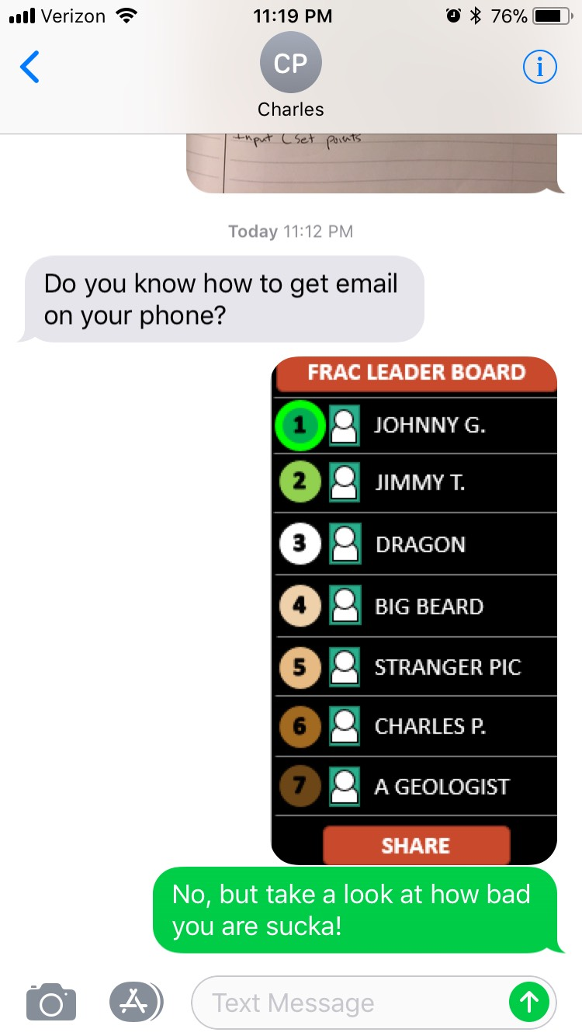
Leaderboard
FRAC LEADER BOARD
1
JOHNNY G.
2
JIMMY T.
Try it @:
https://goo.gl/qeTRf1v
3
DRAGON
4
BIG BEARD
5
STRANGER PIC
6
CHARLES P.
7
A GEOLOGIST
SHARE
https://goo.gl/qeTRf1

Slide 11





So What?
Increasing rate by 5 bpm during last 3rd of the stage yields stage 1.5 min faster
$$Time Saved\left(hr\right)∗(Fixed Hourly Rate \left(\frac{\$}{hr}\right)+Variable Rate (\frac{\$}{hr})$$
$$\frac{1.5}{60}∗\left(\$5,100+\$10,640\right)=\frac{\$393}{Stage}$$
$$\frac{\$393}{Stage}∗\frac{10 Stages}{Day}∗\frac{255 Days}{Year}=\frac{\$1 MM}{Year}$$
https://goo.gl/qeTRf1

